Slide 1
Introduction:
One of the biggest pizza delivery and carryout businesses, Domino's Pizza, Inc. is well-known throughout the world for its strong brand. A publicly traded firm (trading under the name "DPZ"), Domino's New York Stock Exchange serves a large selection of pizzas with different toppings and mainly provides supplementary menu items like pasta, chicken, sandwiches, breadsticks, desserts, and drinks. Most Domino's stores are owned and operated by franchisees. Domino's is known for its extensive use of technology, which separates it from other quick-service restaurants and creates brand loyalty in every market it enters. Examples of this are its online ordering site, mobile apps, and live tracking pizza. The headquarters of Domino's worldwide are situated in Ann Arbor, Michigan.
Tom and James Monaghan founded the company in 1960 in Ypsilanti, Michigan when they purchased a small, local pizzeria called "DomiNick's". Tom Monaghan later bought his brother out and renamed and rebranded the new business as Domino's Pizza, which used franchising and emphasized speedy delivery in its business model. Over the next few decades, Domino's will become a global brand and operate in over 90 countries and thousands of stores. Ultimately, Domino's went from a small, regional pizza store to one of the world's leading fast-food chains, through franchising, but built out its offerings on values such as affordability, consistency, and innovation.

Slide 2
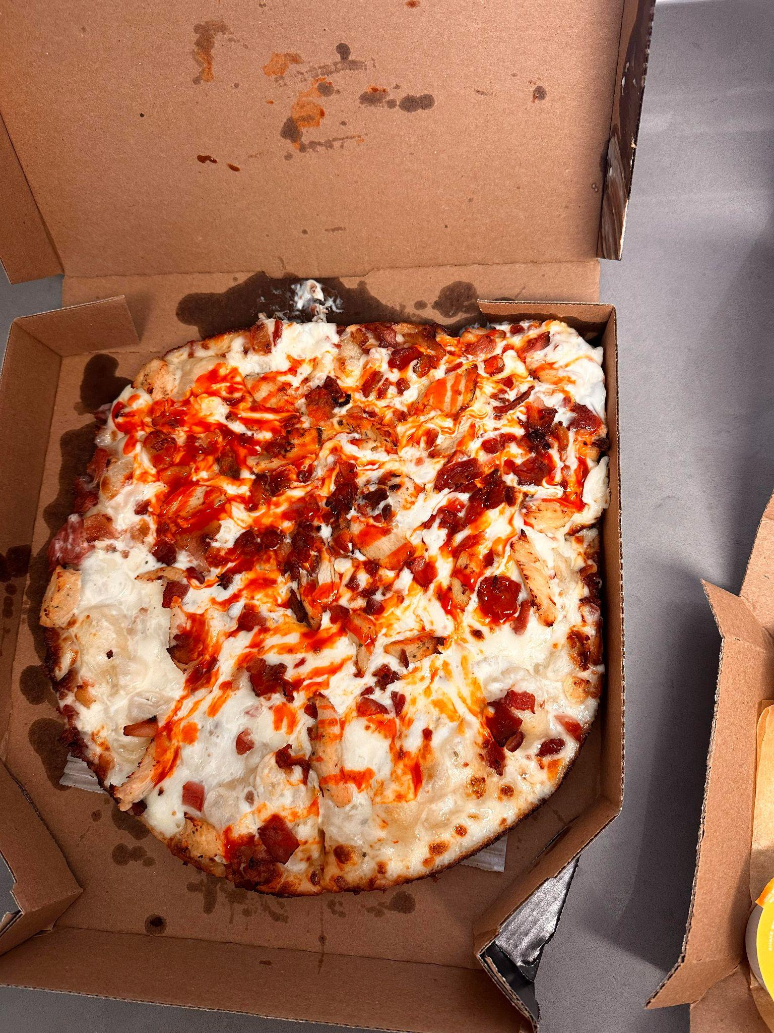
Issue/ Problem Towards The Company:
Particularly during peak hours, Domino's Pizza struggles to maintain consistent delivery speed, order accuracy, and quality control. Inaccurate or poor orders and delayed deliveries are caused by ineffective route planning, large order quantities, and unpredictable system problems. These problems lower consumer happiness and draw attention to the necessity of operational upgrades that increase delivery accuracy, efficiency, and overall service quality.

Slide 3
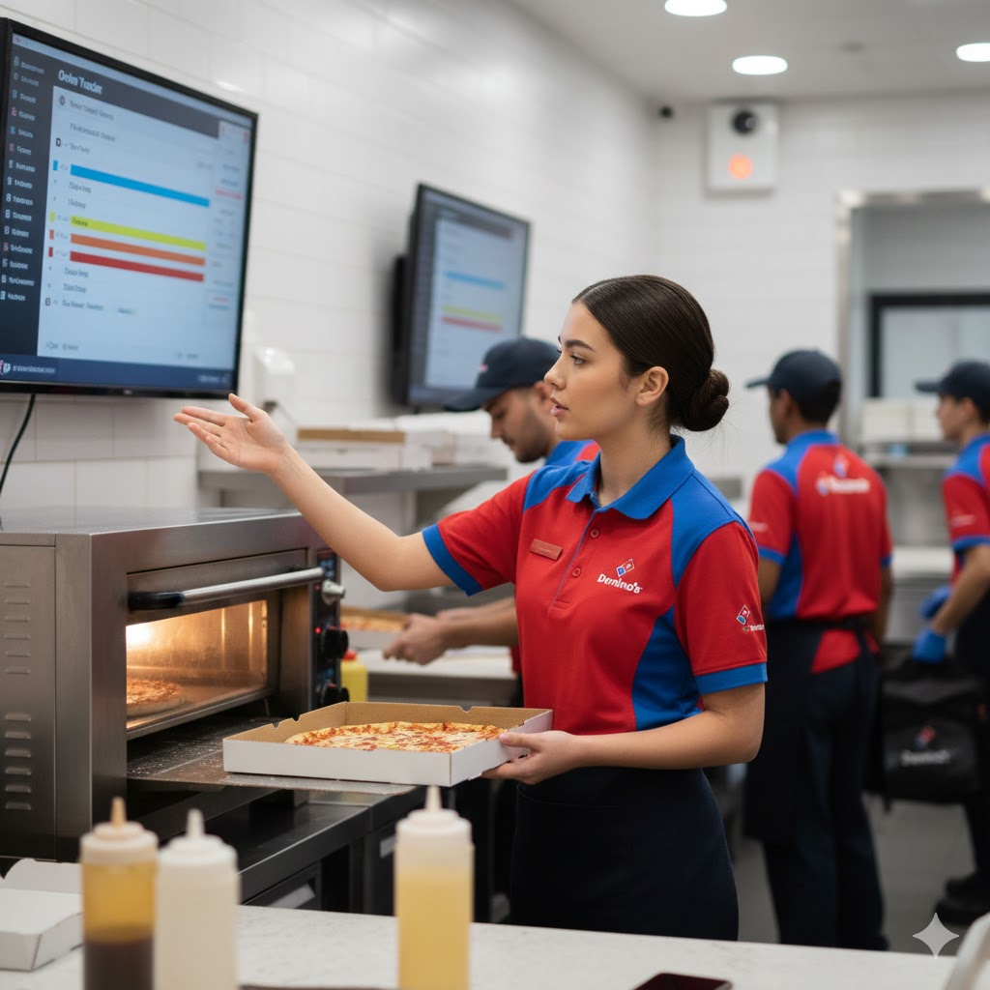
Mission Statement and Strategy:
From 17 to 19, I used to be a Customer Service Representative (CSR) for Domino's Store Code 7840 in Downey. One of the biggest complaints I used to get from customers is that Dominos lacks pizza quality, timing on the pizza, and app malfunction (app shows $6.99 Mix & Match Deal but charges you $7.99 at CheckOut). Dominos must adopt a comprehensive approach with an emphasis on personnel management, process optimization, and technology innovation. Domino's has long depended on its guarantee of accurate, timely, and hot pizza delivery. But as consumer demand increases and service standards change, the firm must improve its processes to sustain operational excellence. The following strategic efforts are intended to improve Domino's effectiveness, dependability, and quality of service, especially during busy business hours.

Slide 4
Apply Innovative Route Efficiency / Strict GPS Tracker for Drivers:
Domino's should use real-time GPS tracking and AI-powered route optimization to improve their present delivery processes. Customers can trace their orders from the oven to their doorstep with the Domino's Tracker, the company's delivery tracking technology. However, Domino's can more effectively distribute delivery resources, balance driver workloads, and lessen delays during times of heavy demand by combining AI scheduling algorithms with predictive traffic information. Also, if the GPS Tracker can notify management that the driver has been inactive for more than a minute, they should send a message to the driver to start working again or the time of inactivity will be punished with no pay per second of inactivity. By dynamically allocating routes according to traffic, weather, and order proximity, this could reduce average delivery times and enhance on-time performance. Mandatory GPS activation during all shifts, rules for drivers to follow when following routes, and recurring performance evaluations based on delivery efficiency indicators are all examples of policies that should support this project.

Slide 5
2. Improving Quality/Accuracy Control
Domino’s accuracy and quality of pizza was one of the biggest complaints I received as an employee at Dominos. Consistently orders were being made wrong, Food Expo was giving the wrong orders to the wrong people, and sometimes the pizza wasn’t cooked correctly but we’d serve it anyway to avoid wasting product. This could have led to huge lawsuits if it landed on the hands of someone who was allergic to one of the ingredients. By putting in place digital order verification systems and kitchen display screens (KDS), which visually verify each order before dispatch, Domino's may improve these features. Order errors can be further decreased by implementing a "double-check" procedure, in which a backup staff member confirms the completed order before sealing. To ensure uniformity across all franchise sites, frequent quality audits and staff retraining initiatives should also be implemented.

Slide 6
Inputs-Process-Output system view of the organization/process
At Domino’s, the Input–Process–Output (IPO) model provides a clear framework for understanding how the company transforms resources into high-quality food and customer satisfaction.
The inputs consist of the essential resources needed to deliver service efficiently. These include raw materials like pizza dough, cheese, sauces, vegetables, and meats; human resources such as chefs, delivery drivers, and customer service representatives; as well as technological resources like online ordering systems, GPS tracking, and kitchen display screens. Capital inputs include ovens, delivery vehicles, and store infrastructure, while informational inputs include customer orders, digital data, and performance metrics collected through the Domino’s Tracker system.
The process stage represents the transformation of these inputs into final products and services. It begins when customers place their orders via the website, app, or phone. Orders are then transmitted to the kitchen for preparation, where staff assemble and bake the pizzas . Each order is checked for quality and accuracy before being packaged for pickup or delivery. Delivery drivers use GPS systems to follow optimized routes, ensuring that pizzas arrive hot and on time. This process also involves customer service operations, such as handling inquiries, managing complaints, and updating customers on order status through the app.

Slide 7
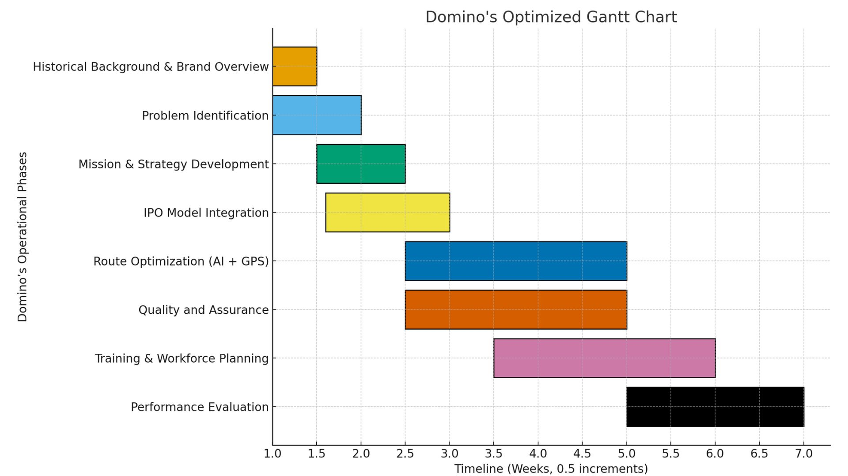
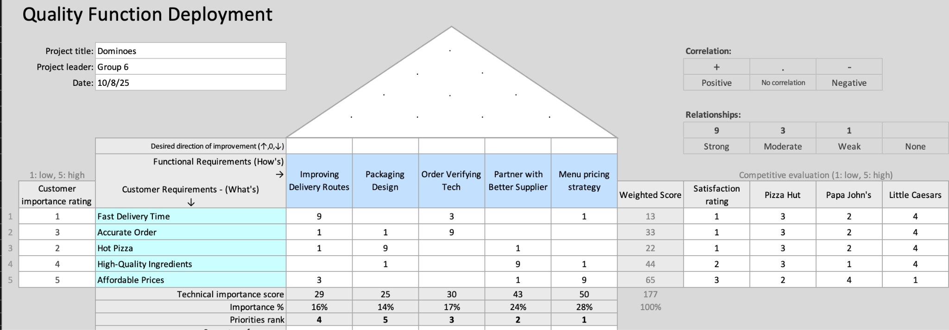
Gantt Chart:
QFD:

Slide 8
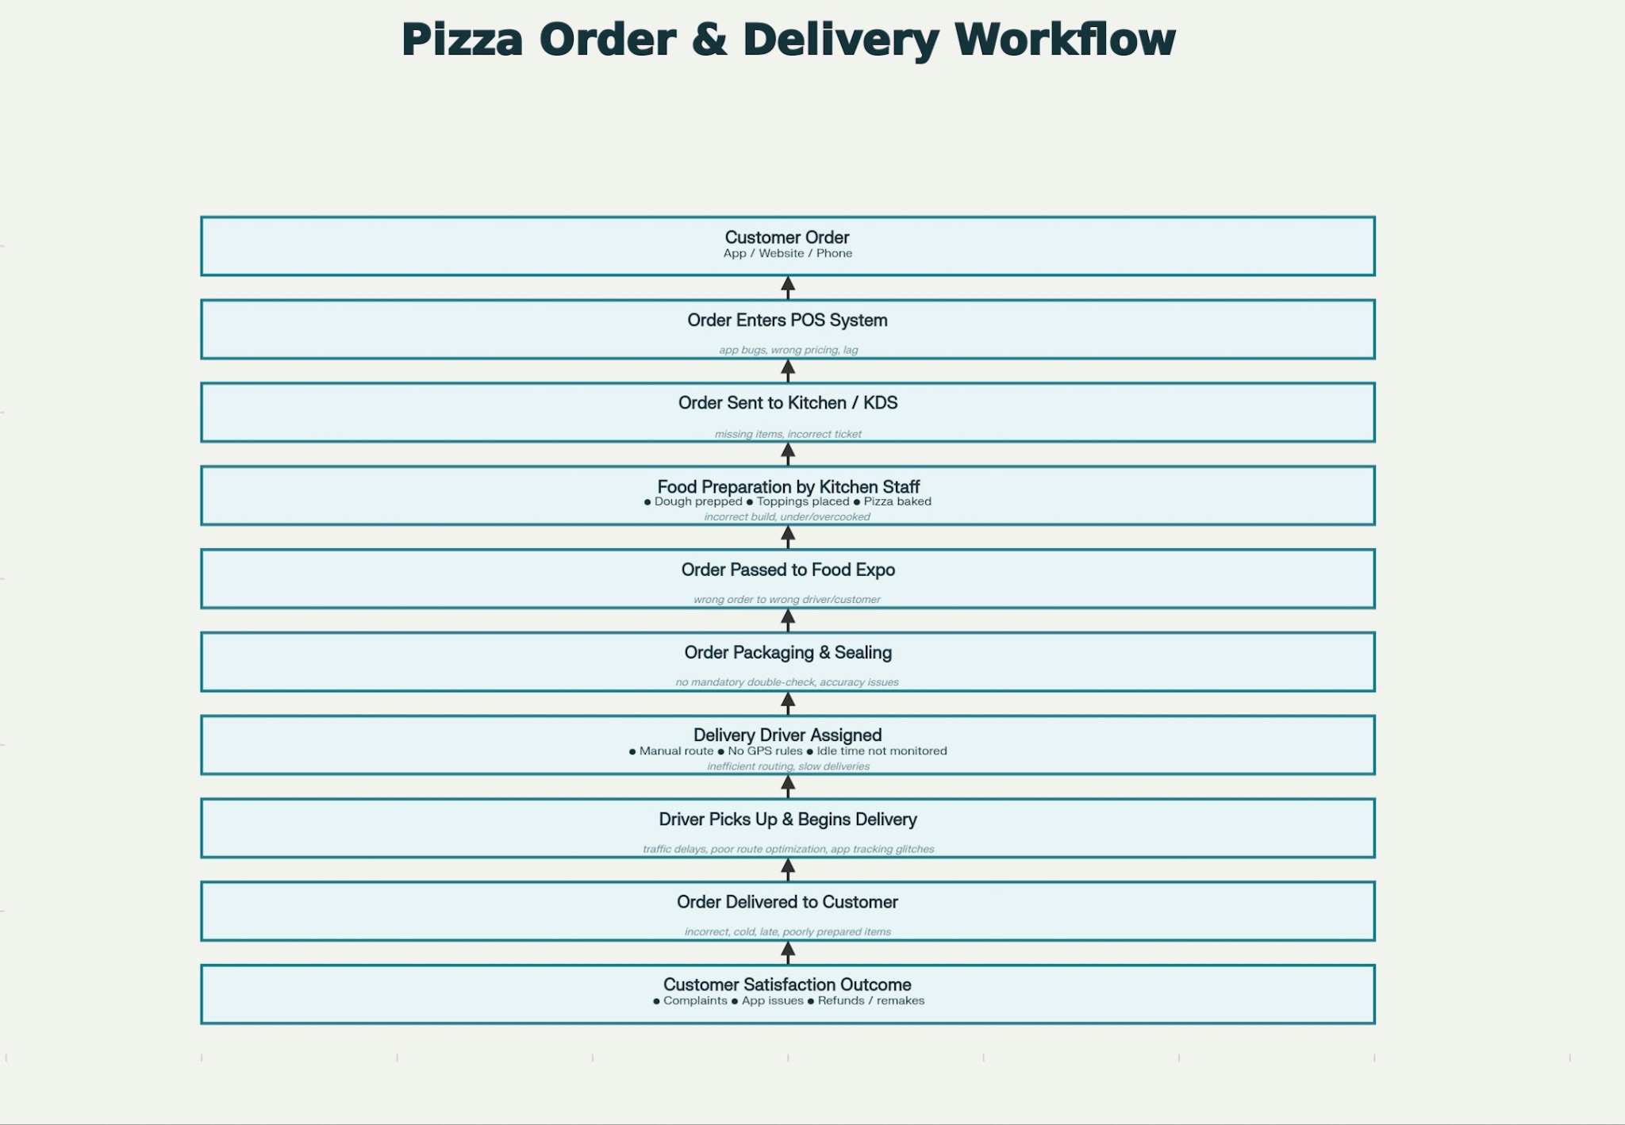
As Is Flowchart

Slide 9
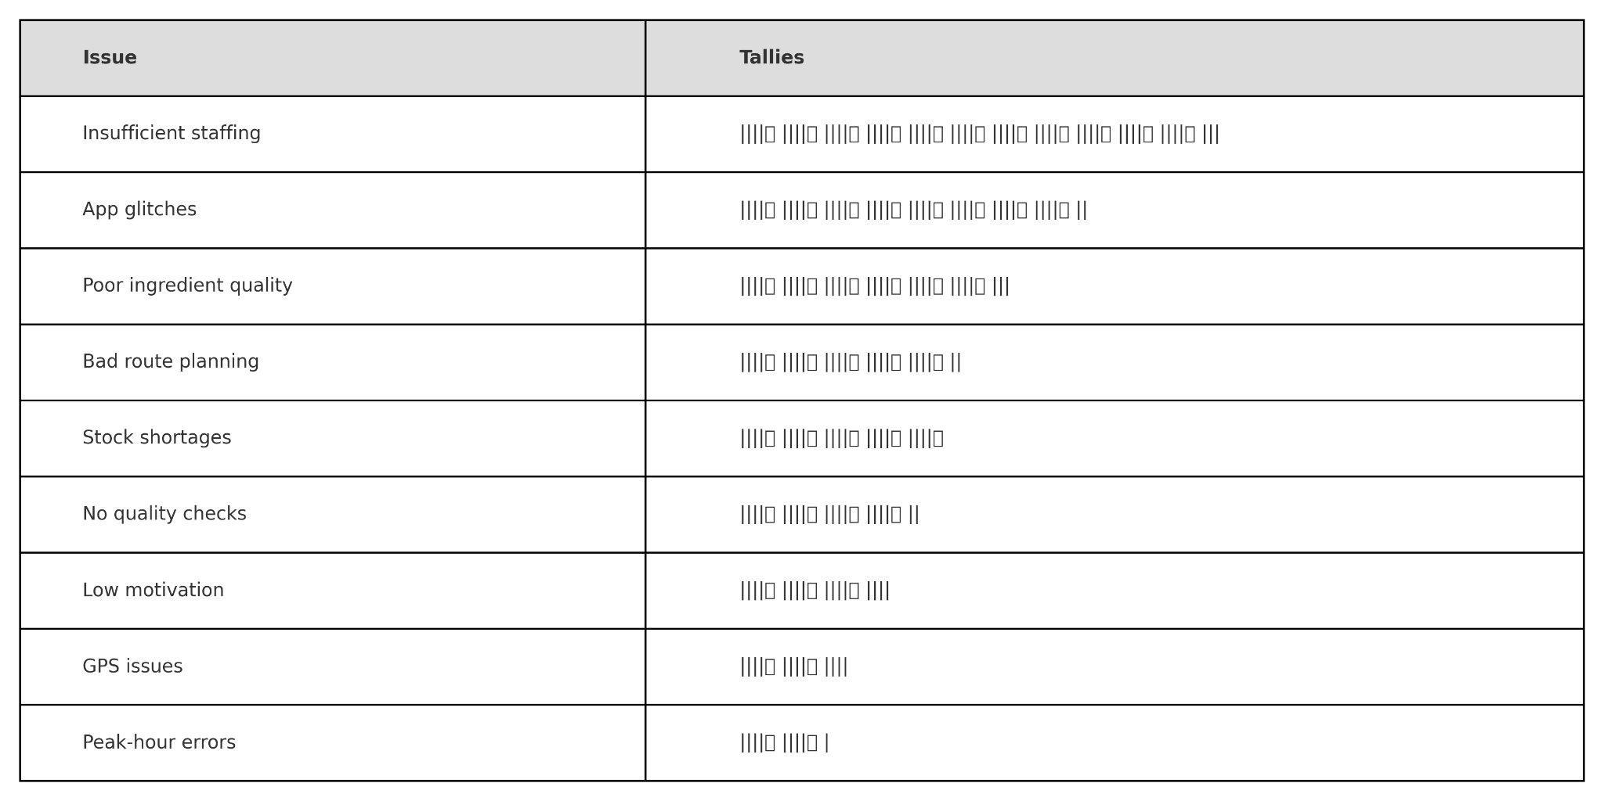
Check Sheet

Slide 10
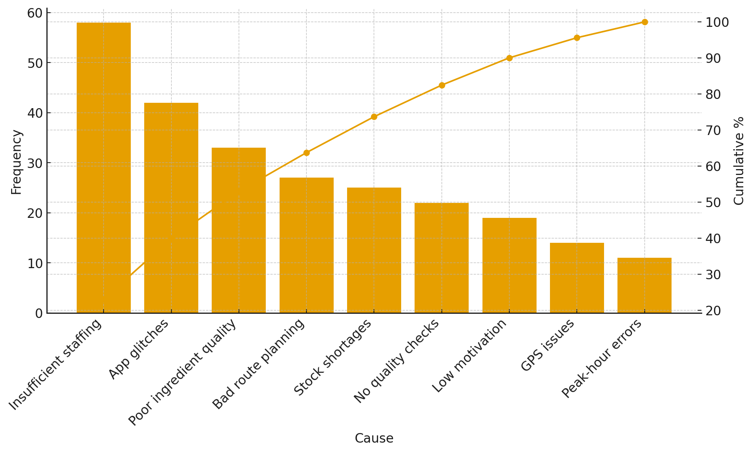
Pareto Diagram

Slide 11
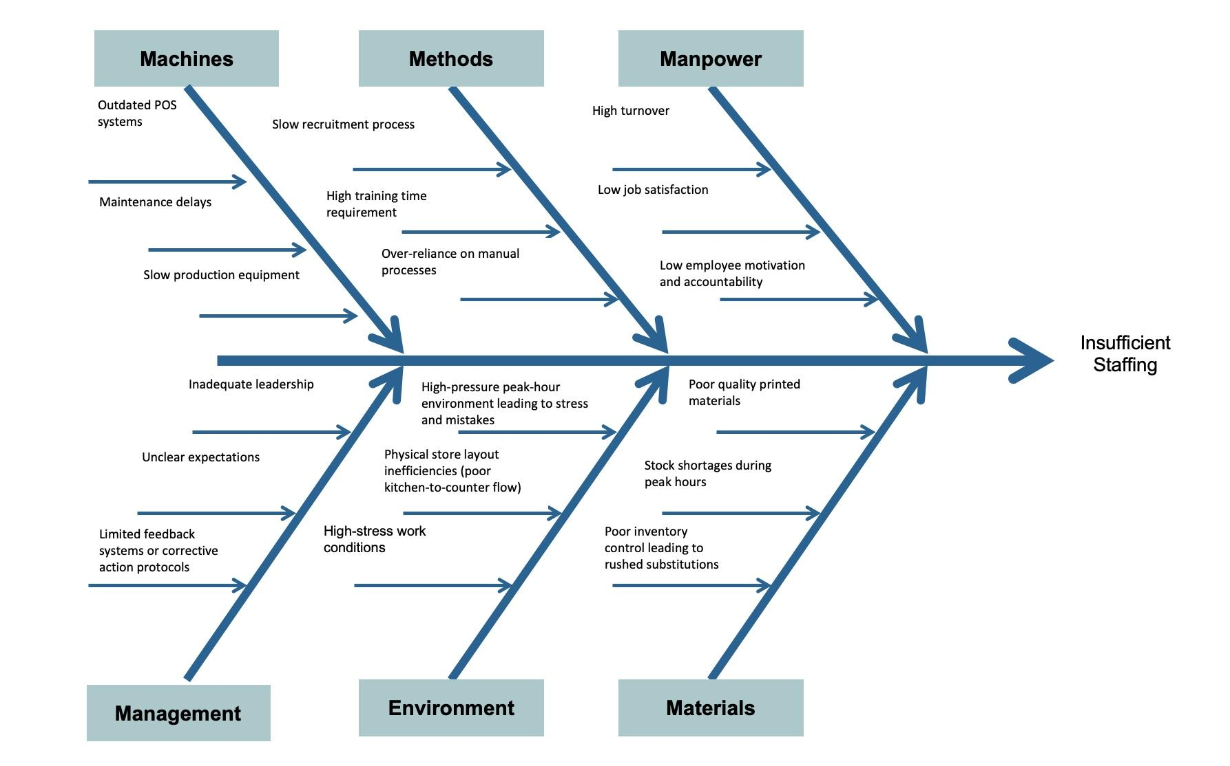
Cause and Effect Chart (Fishbone Chart)

Slide 12
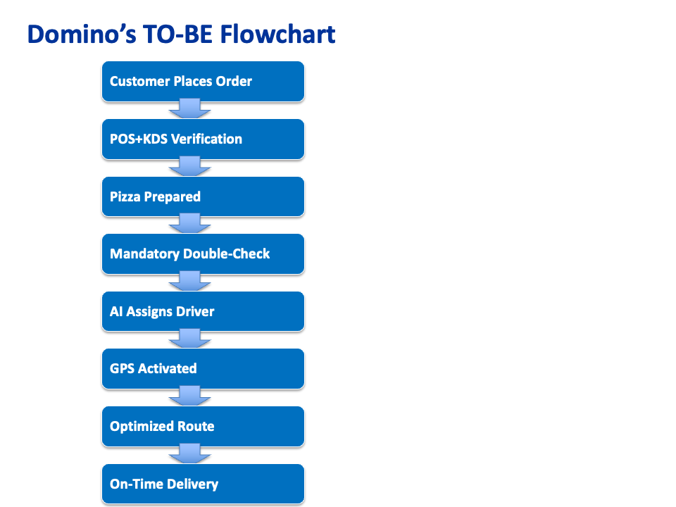
TO BE FLOW CHART
The proposed “to-be” process focuses on making Domino’s operations smoother, faster, and way more reliable by using better technology and clearer steps. In the improved system, customers still place their orders the same way—through the app, website, or in-store—but now the order goes into an upgraded POS system that works with a more efficient KDS. The kitchen team follows the usual prep routine, but before the order gets bagged, it goes through a required digital double-check. One employee finishes the order and another quickly confirms that the toppings, cooking, and accuracy match what the customer ordered.
After the order is approved, the system automatically assigns a delivery driver using AI that looks at traffic, delivery distance, and how busy the store is. The driver’s GPS turns on right away and gives them the best route to take. If the driver stops moving for more than a minute, management gets an alert so they can step in if needed. The delivery gets to the customer quicker and with fewer mistakes, and customers can track everything in real time. Once the order is complete, the system collects customer feedback automatically, which helps managers improve training, scheduling, and future operations. Overall, this upgraded process cuts down on errors, keeps things running smoothly during peak hours, and helps Domino’s deliver a much more consistent and satisfying experience for customers.
Notes:
Í

